Slide 1
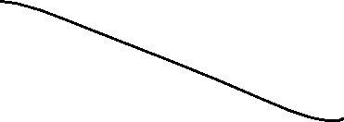

isButtonPressed(SET_VALUE_BUTTON)==1
NORMAL
RED_MODE
isButtonPressed(MODE_BUTTON)==1
isButtonPressed(MODE_BUTTON)==1
OR isButtonPressed(SET_VALUE_BUTTON)==1
isButtonPressed(MODE_BUTTON)==1
isButtonPressed(SET_VALUE_BUTTON)==1
GREEN_MODE
YELLOW_MODE
isButtonPressed(MODE_BUTTON)==1

Slide 2
Fsm for led 7 seg
Use two seven-segment LEDs to display the value. - Use the other two seven-segment LEDs to display the mode
bufferForLed[4]

